Slide 1


Migration path from SQL Server Instance on Azure VM (IaaS) towards Azure SQL Managed Instance (PaaS)
Zoran Barac, Data Architect at CIN7
www.linkedin.com/in/zoran-barac/
blog.sqlserveronline.com/

Slide 2








Explore your PASS community
Own your career with interactive learning built by community and guided by data experts.
Get involved. Get ahead.
Free online webinar events
Local user groups around the world
Connect with the global data community
.org
Online special interest user groups
Learning on-demand and delivered to you
Get involved

Slide 3
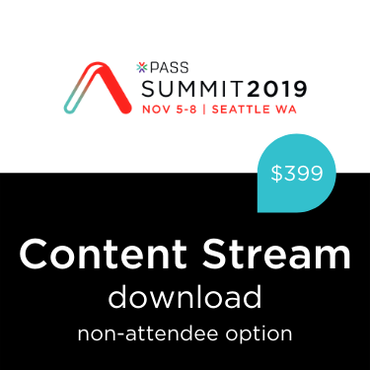
Missed PASS Summit 2019?
Get the Recordings
Download all PASS Summit sessions on Data Management, Analytics, or Architecture for only $399 USD
More options available at PASSstuff.com

Slide 4

We are thrilled to say the first ever PASS Virtual Summit will be taking place this November!
We will be launching PASS Summit into a whole new world, and with that comes exciting opportunities with what we can offer you. We will go beyond simply moving sessions online to fully embracing everything a virtual environment can offer.
Find out more at PASS.org/summit

Slide 5





Thank you to our Global Sponsors and Supporters

Slide 6
This event was sponsored by Microsoft Learn more about SQL Server 2019 today: -Get free training: aka.ms/sqlworkshops -Download the SQL19 eBook: aka.ms/sql19_ebook

Slide 7

Agenda
Cloud deployment options - Hosted service (PaaS), or a hosted infrastructure (IaaS)
Migration Plan - Target platform selection, Migration tools selection
Azure SQL Managed Instance and architectural models
Migration from IaaS VM SQL Server instance to Azure SQL Managed Instance
Data Migration Assistant (DMA)
Database Experimentation Assistant (DEA)
Database Migration Services (DMS)

Slide 8
Choose the right deployment option - Hosted service (PaaS), or a hosted infrastructure (IaaS)

Slide 9
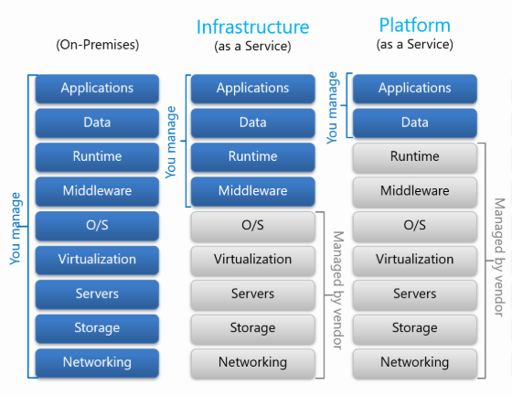
Cloud models: IaaS, PaaS

Slide 10
Migration Plan -Target platform selection, Migration tools selection

Slide 11
Which SQL option should I choose?
Azure SQL Database (PaaS) | SQL Managed Instances (PaaS) | SQL Virtual Machines (IaaS)
PROS: 99.995% availability guaranteed. Built-in backups, patching, recovery. Latest stable Database Engine version. Online change of resources (CPU/storage). The most commonly used SQL Server features are available. Ability to assign necessary resources (CPU/storage) to individual databases. CONS: Migration might be hard. Some SQL Server features are not available. Private IPs cannot be assigned (you can limit the access using firewall rules). | PROS: 99.99% availability guaranteed. Built-in backups, patching, recovery. Latest stable Database Engine version. Online change of resources (CPU/storage). Supports almost all on-premises instance/database level capabilities. High compatibility with SQL Server on-premises. Easy migration from SQL Server. Private IPs within Azure VNet. CONS: There is still some minimal number of SQL Server features that are not available. | PROS: Up to 99.99% availability. Supports all on-premises capabilities. You have full control over the SQL Server engine. Full parity with the matching version of on-premises SQL Server. Fixed, well-known database engine version. Easy migration from SQL Server on-premises. CONS: You need to manage your backups and patches. You need to implement your own High-Availability solution. There is a downtime while changing the resources(CPU/storage)

Slide 12
Migration tools selection
 | Single database and elastic pool | Managed Instance and instance pools
SQL Server (on-prem, Azure VM) | Online: Data Migration Service (DMS), Transactional Replication Offline: BACPAC file (import), BCP | Online: Data Migration Service (DMS), Transactional Replication Offline: Native backup/restore, BACPAC file (import), BCP, Snapshot replication
Single database | Offline: BACPAC file (import), BCP | Offline: BACPAC file (import), BCP
Azure SQL Managed Instances | Online: Transactional Replication Offline: BACPAC file (import), BCP, Snapshot replication | Online: Transactional Replication Offline: Cross-instance point-in-time restore (Azure PowerShell or Azure CLI), Native backup/restore, BACPAC file (import), BCP, Snapshot replication

Slide 13
Azure SQL Database Managed Instance and Architectural Models

Slide 14
Service tier characteristics
 | General Purpose | Business Critical
Number of vCores* | Gen4: 8, 16, 24 Gen5: 4, 8, 16, 24, 32, 40, 64, 80 | Gen4: 8, 16, 24 Gen5: 4, 8, 16, 24, 32, 40, 64, 80
Max memory | Gen4: 56 GB - 168 GB (7GB/vCore) Gen5: 20.4 GB - 408 GB (5.1GB/vCore) Add more vCores to get more memory. | Gen4: 56 GB - 168 GB (7GB/vCore) Gen5: 20.4 GB - 408 GB (5.1GB/vCore) for read-write queries + additional 20.4 GB - 408 GB (5.1GB/vCore) for read-only queries.
Max instance storage size (reserved) | - 2 TB for 4 vCores (Gen5 only) - 8 TB for other sizes | Gen4: 1 TB Gen5: 1 TB for 4, 8, 16 vCores / 2 TB for 24 vCores / 4 TB for 32, 40, 64, 80 vCores
Max tempDB size | Limited to 24 GB/vCore (96 - 1,920 GB) | Up to currently available instance storage size.
Data/Log IOPS (approximate) | Up to 30-40 K IOPS per instance*, 500 - 7500 per file | 10 K - 200 K (2500 IOPS/vCore) Add more vCores to get better IO performance.
Log write throughput limit (per instance) | 3 MB/s per vCore Max 22 MB/s | 4 MB/s per vCore Max 48 MB/s
Data throughput (approximate) | 100 - 250 MB/s per file | Not limited.
Storage IO latency (approximate) | 5-10 ms | 1-2 ms
In-memory OLTP | Not supported | Available, size depends on number of vCore
Read-only replicas | 0 | 1 (included in price)

Slide 15
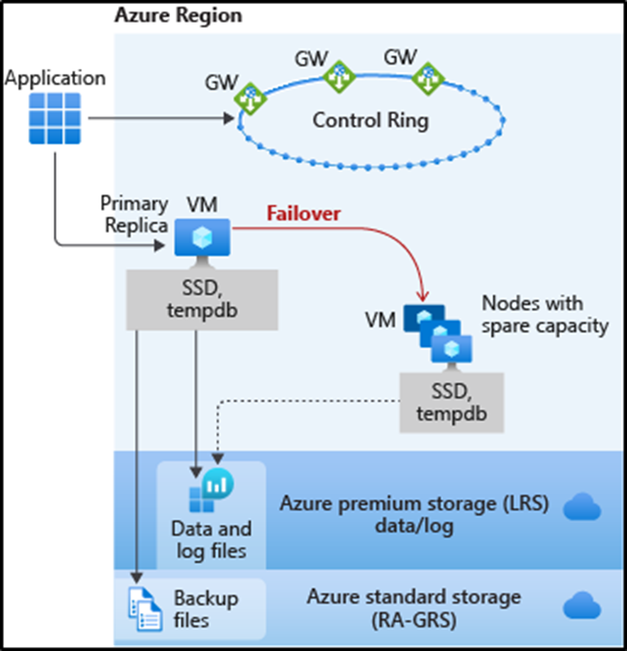
General Purpose service tier availability
The standard availability model includes two layers:
Compute layer that runs the sqlserver.exe process (contains only transient and cached data on the attached SSD, such as TempDB, model database, plan cache, buffer pool ).
Data layer with the database files (.mdf/.ldf) that are stored in Azure Blob storage. Azure blob storage has built-in data availability and redundancy feature.

Slide 16
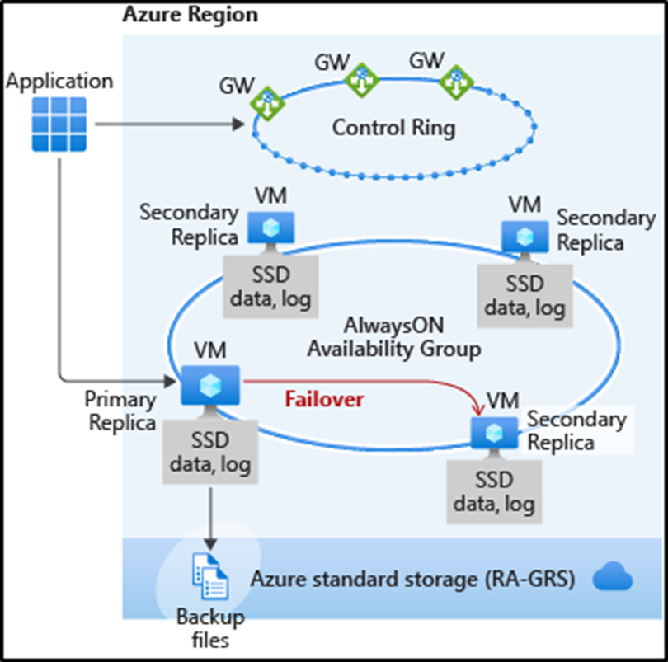
Business Critical service tier availability
Business Critical service tiers leverage the Premium availability model, which integrates compute resources (SQL Server Database Engine process) and storage (locally attached SSD) on a single node.
High availability is achieved by replicating both compute and storage to additional nodes creating a three to four-node cluster.

Slide 17
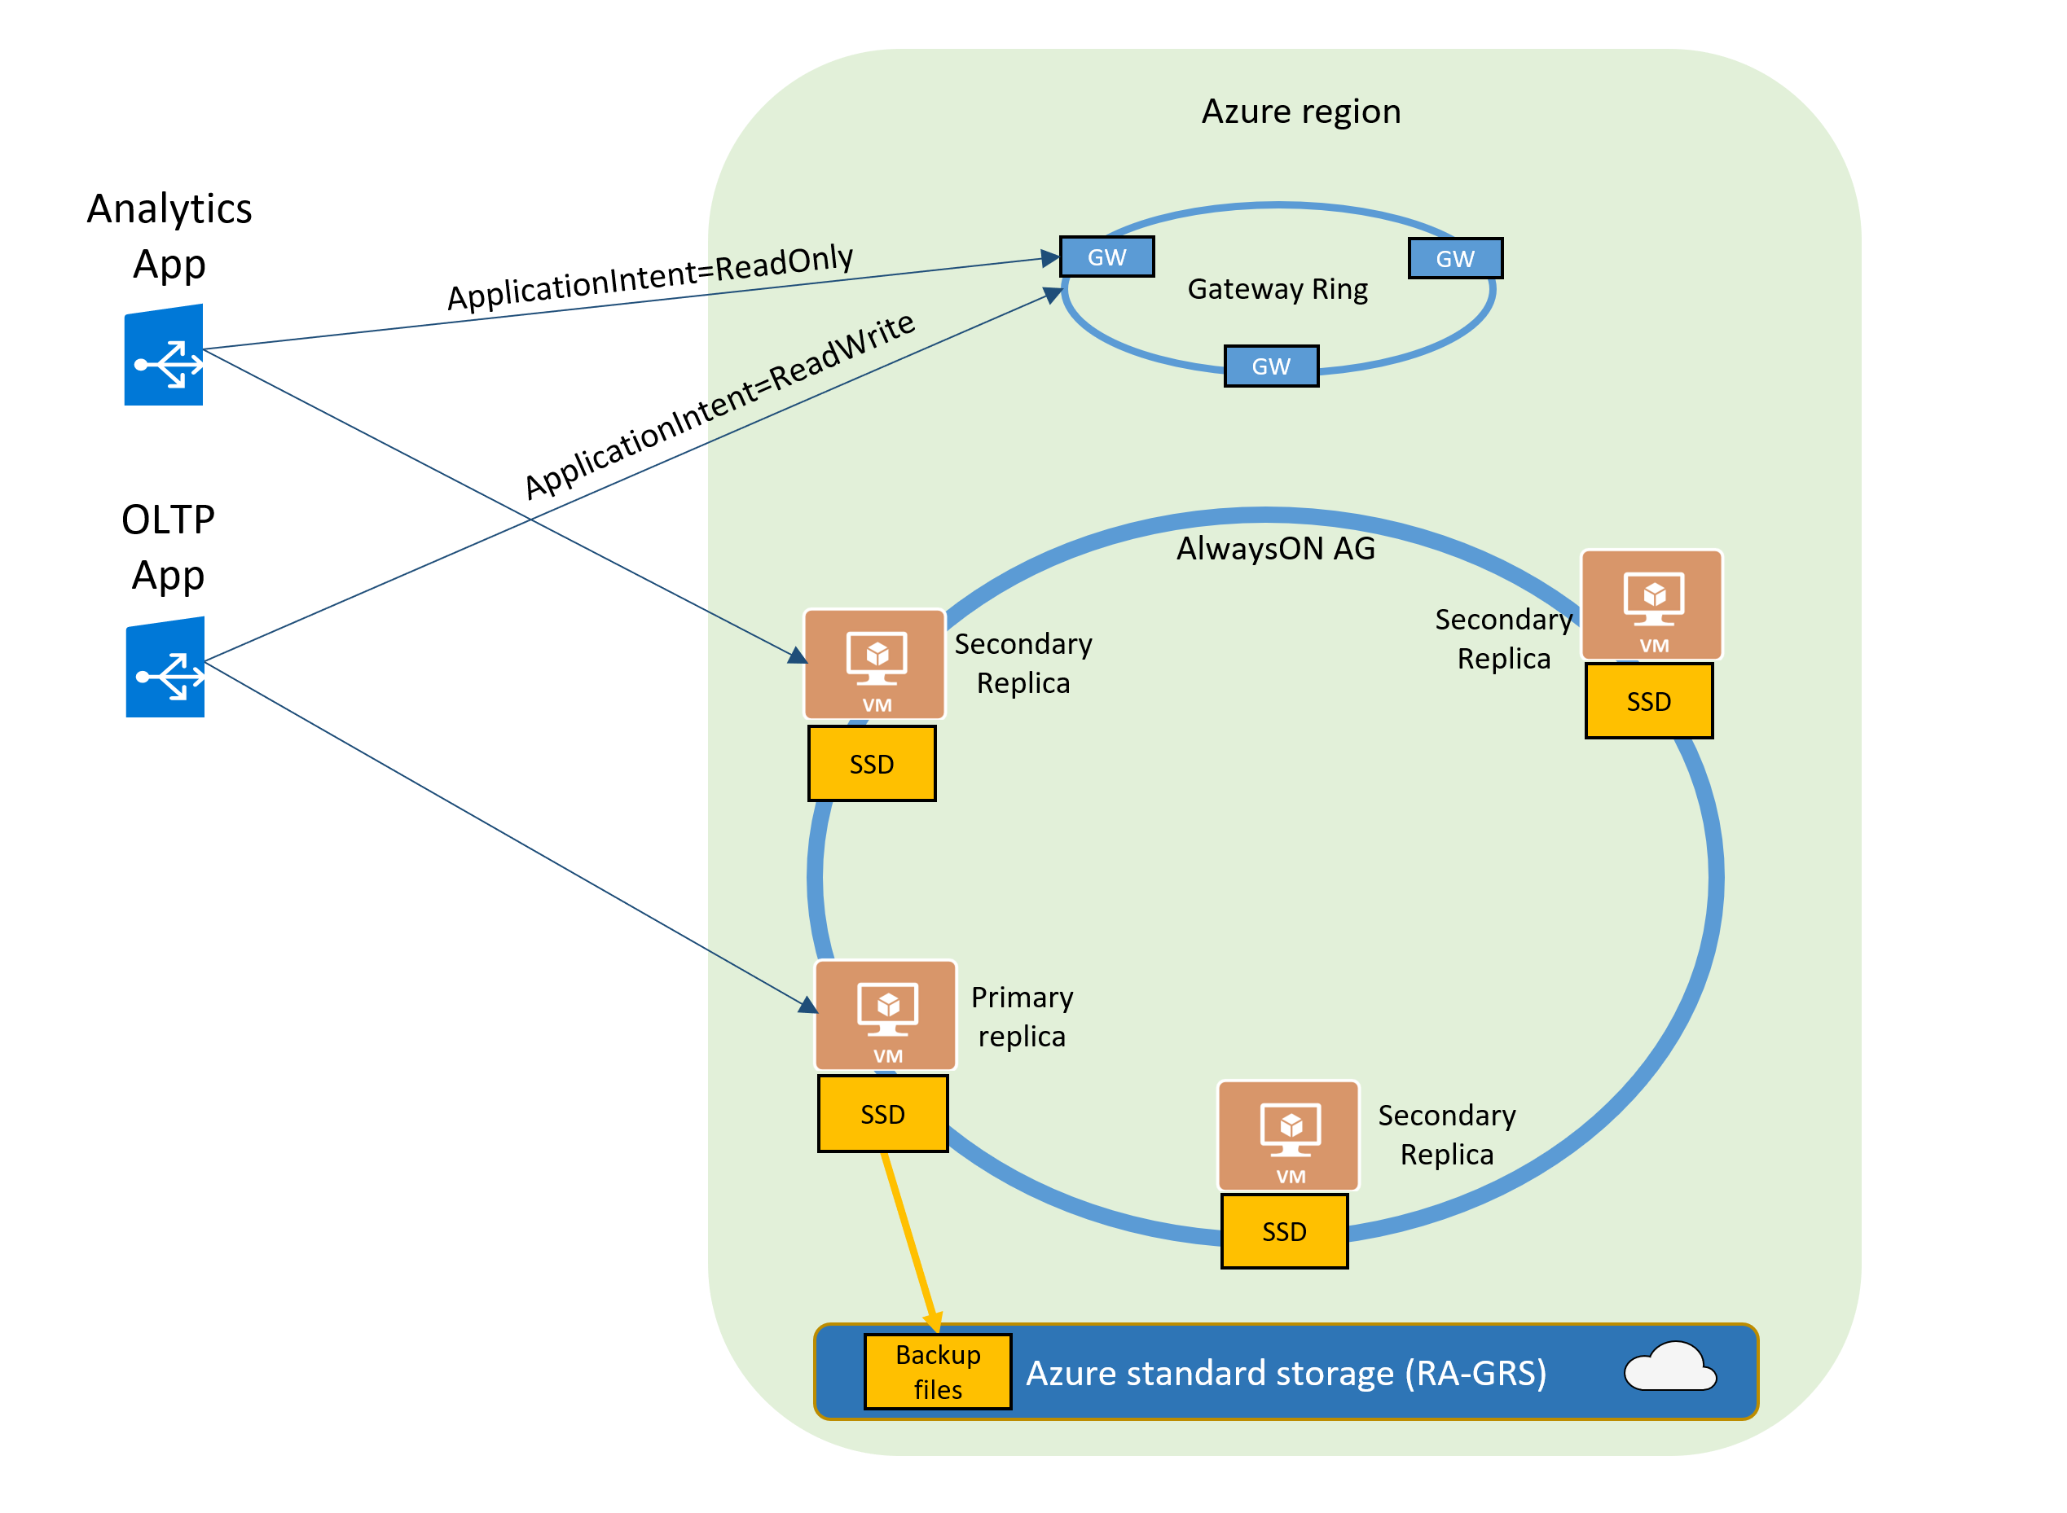
Read-only replicas and read-only query workloads
The Read Scale-Out feature is enabled by default on new Premium, Business Critical, and Hyperscale databases.
In case of Azure SQL Managed Instance it will be Business Critical service tier.
If your SQL connection string is configured with ApplicationIntent=ReadOnly, the application will be redirected by the gateway to a read-only replica of that database.

Slide 18
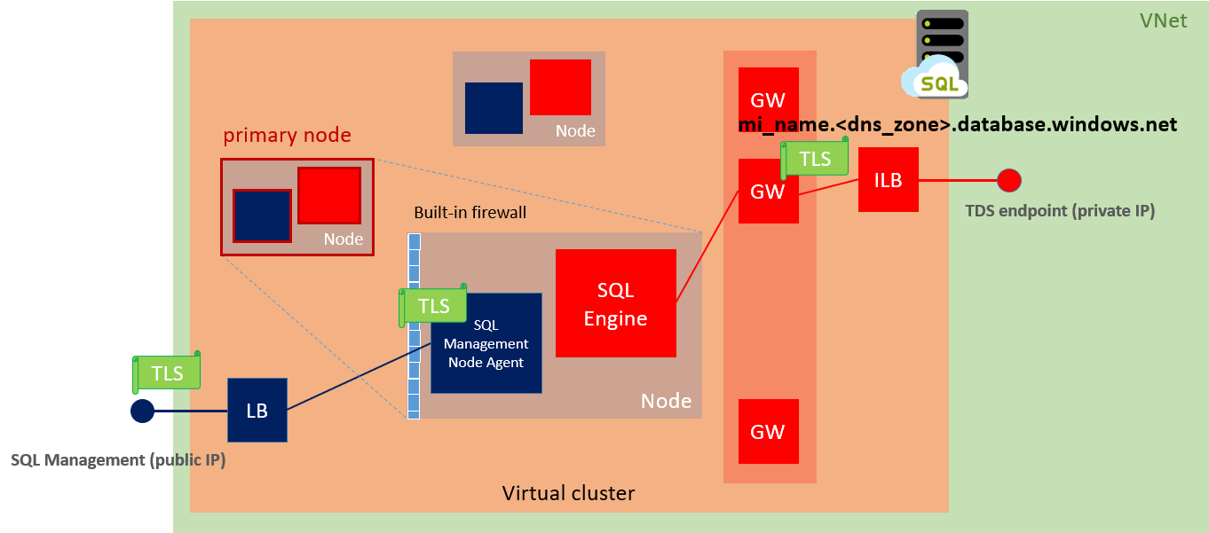
Virtual cluster connectivity architecture

Slide 19
Migration from IaaS VM SQL Server instance to Azure SQL Managed Instance

Slide 20
Database migration from IaaS VM SQL Server instance to Azure SQL MI
Step 1. Data Migration Assistant (DMA)
First step will be to determine whether Azure SQL Managed Instance is compatible with the database requirements of business application.
Step 2. Database Experimentation Assistant (DEA)
Database Experimentation Assistant (DEA) is an experimentation solution for SQL Server upgrades. The DEA tool helps to evaluate the effects on database performance, of database migration between different SQL Server instances.
Step 3. Database Migration Service (DMS)
Azure Database Migration Service is designed as a seamless, end-to-end solution for moving on-premises SQL Server databases to the cloud.

Slide 21
Data Migration Assistant (DMA)

Slide 22
Data Migration Assistant (DMA)
Using Data Migration Assistant (DMA) tool we can detect potential compatibility issues which may impact our database functionality after migration to Azure SQL managed Instance.
Three major categories under which DMA reports all issues are
Breaking changes, Behavior changes, Deprecated features
DMA main functionalities:
Discover issues that can affect an upgrade to an on-premises SQL Server
Discover new features in the target SQL Server platform
Migrate an on-premises SQL Server instance to a modern SQL Server instance

Slide 23
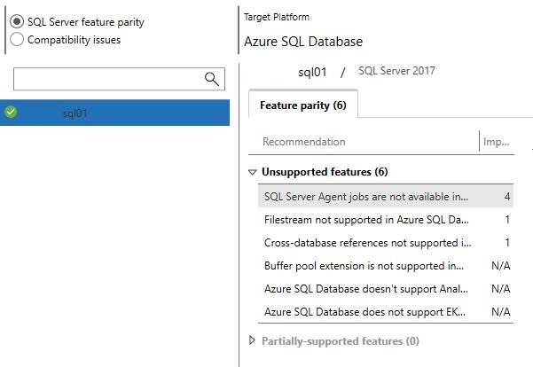
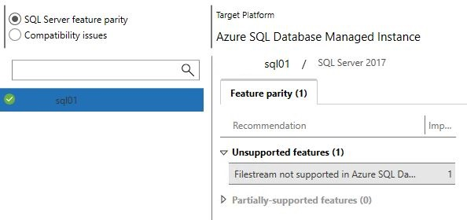
DMA / Instance Level – Azure SQL Database / Azure SQL MI
Azure SQL Database | Azure SQL Managed Instance

Slide 24
SQL Server feature parity – unsupported features example
Azure SQL Database
Buffer pool extension is not supported in Azure SQL Database
Azure SQL Database doesn’t support Analysis Services; migrate to Azure Analysis Services
Cross-database references not supported in Azure SQL Database
Filestream not supported in Azure SQL Database
SQL Server Agent jobs not available in Azure SQL Database
Azure SQL Managed Instance
Filestream not supported in Azure SQL Database

Slide 25
Data Migration Assistant (DMA)
Step by step

Slide 26
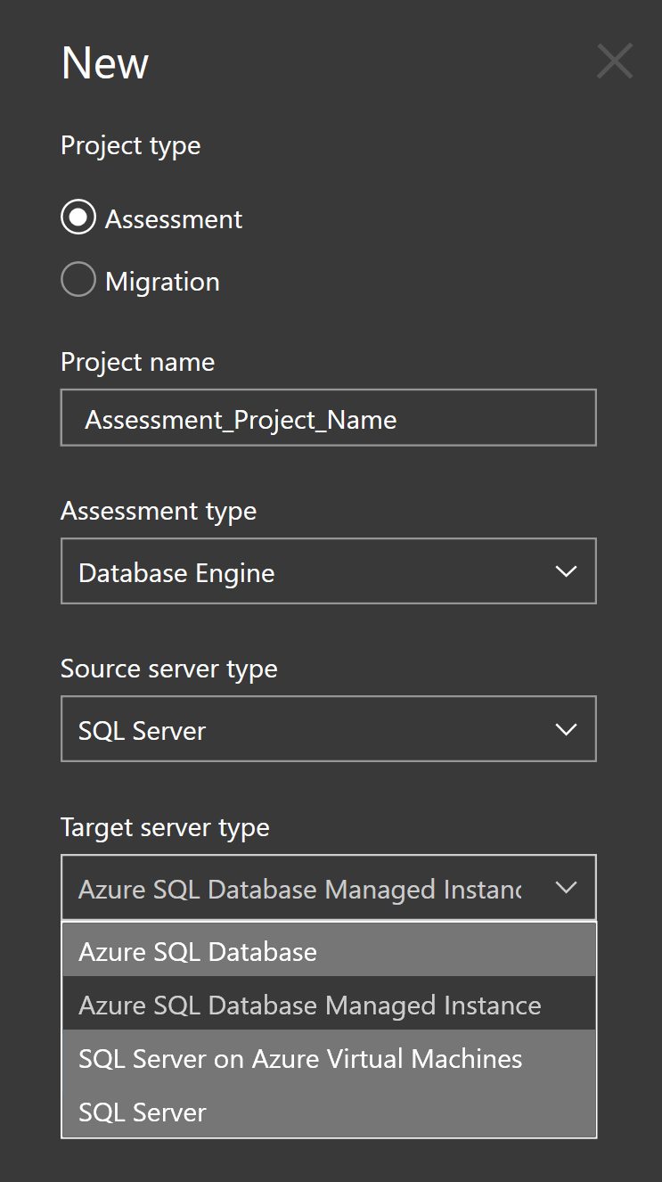
DMA 01
Run the DMA tool and create new project.
Although you can use DMA for schema and data migration as well I wouldn’t recommend this tool for the big databases migration, just for the assessment.
Choose the project type (Assessment), source and target server type. In this example I used SQL Server as a source and Azure SQL Managed Instance as a target server type.

Slide 27
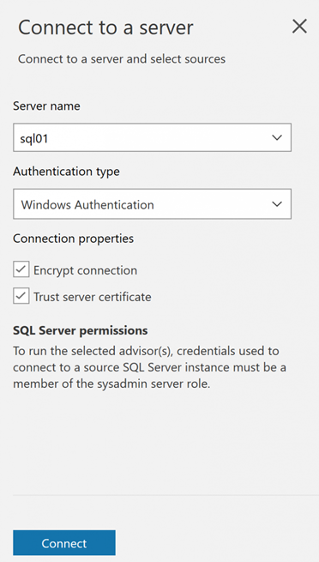
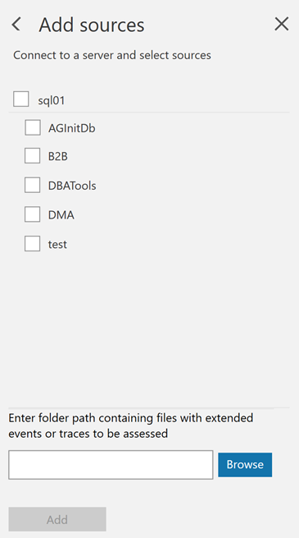
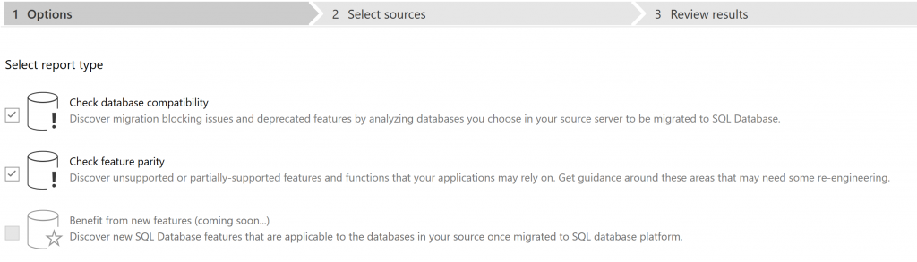
DMA 02
Next step is to select report type. In this example we will check possible compatibility issues that may block our migrating to the cloud. DMA as well provides recommendations to help you address those issues. | Connect to the server and select source databases

Slide 28
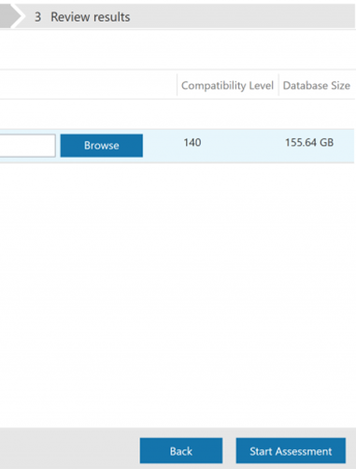
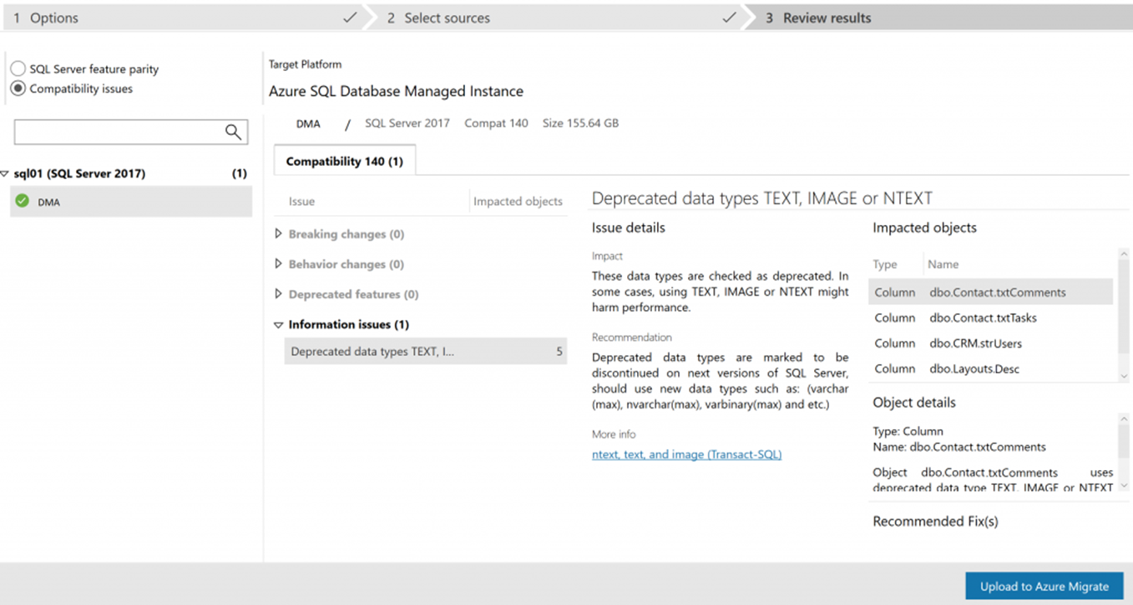
DMA 03
Start assessment | As you can see from the picture bellow possible compatibility issues may be: Breaking changes, Behavior changes, Deprecated features

Slide 29
Database Experimentation Assistant (DEA)

Slide 30
Database Experimentation Assistant (DEA)
Database Experimentation Assistant (DEA) is an experimentation solution for SQL Server upgrades. DEA can help you evaluate a targeted version of SQL Server for a specific workload.
DEA analysis metrics include:
• Queries that have compatibility errors.
• Degraded queries and query plans.
• Other workload comparison data.
Comparison data can lead to higher confidence and help ensure a successful upgrade and migration experience.

Slide 31


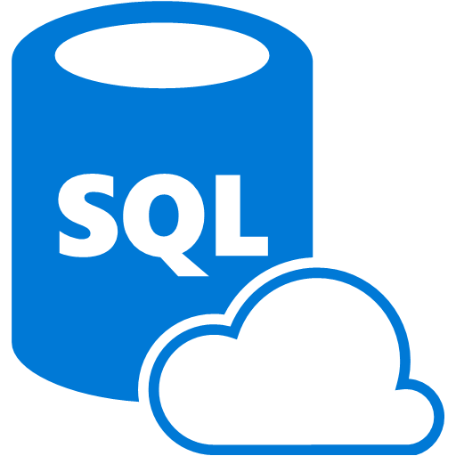

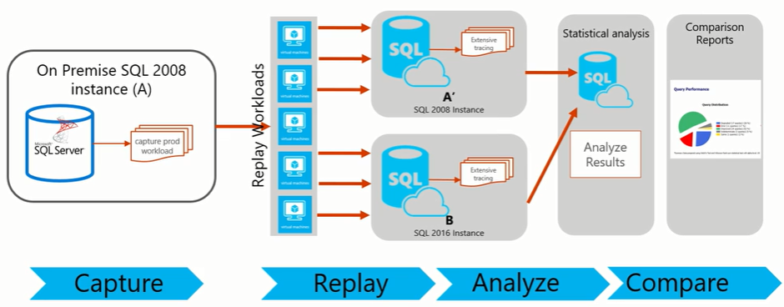
DEA – Architecture (InBuilt Replay Tool and XEvents)
Azure VM
DEA V2.6
SQL 2017
SSAS
Azure VM SQL Server 2017
Instance
Azure SQL Managed Instance
DEA Analysis Reports
Capture production workload (XE trace)
Replay production workload (XE trace)

Slide 32
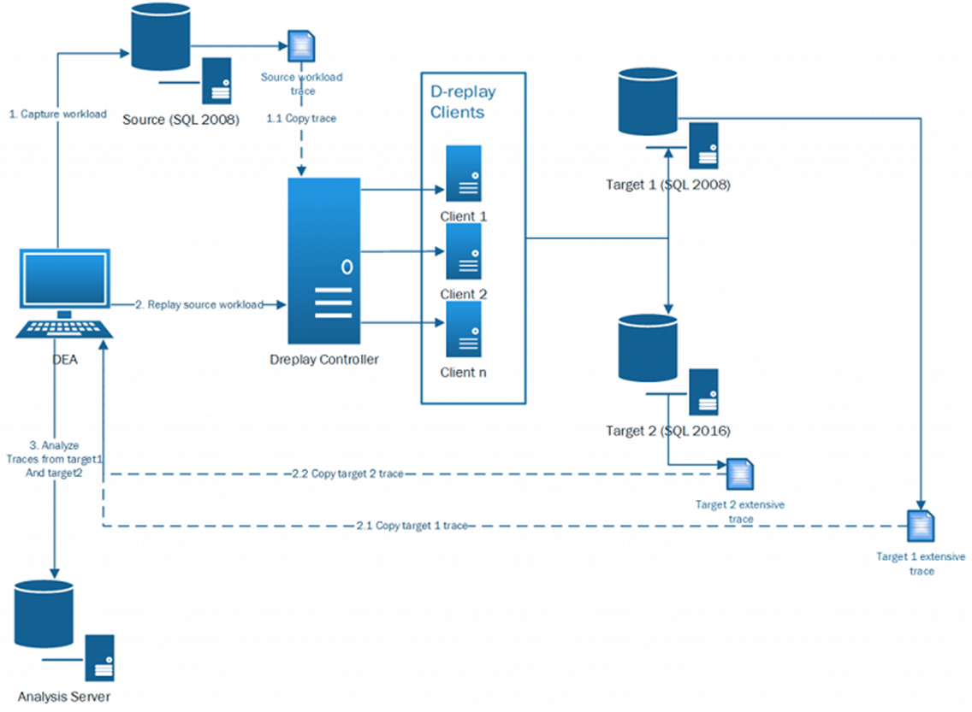
DEA – Architecture (DReplay Replay Tool and Trace)

Slide 33
Database Experimentation Assistant (DEA) step by step

Slide 34
Database Experimentation Assistant (DEA)
Using Database Experimentation Assistant (DEA) you can evaluate your current production workload from your current environment and analyze how will that workload perform in your new targeted environment.
For this example we are going to use following:
Source: SQL Server 2017, 32CPU, 256GB Memory
Target: Azure SQL Managed Instance, BC Gen5 (16 vCores, 80GB Memory)
DEA VM: SQL Server 2017, 4CPU, 32GB Memory
Workload: 10minutes XE trace (XEL), size 19.9GB

Slide 35
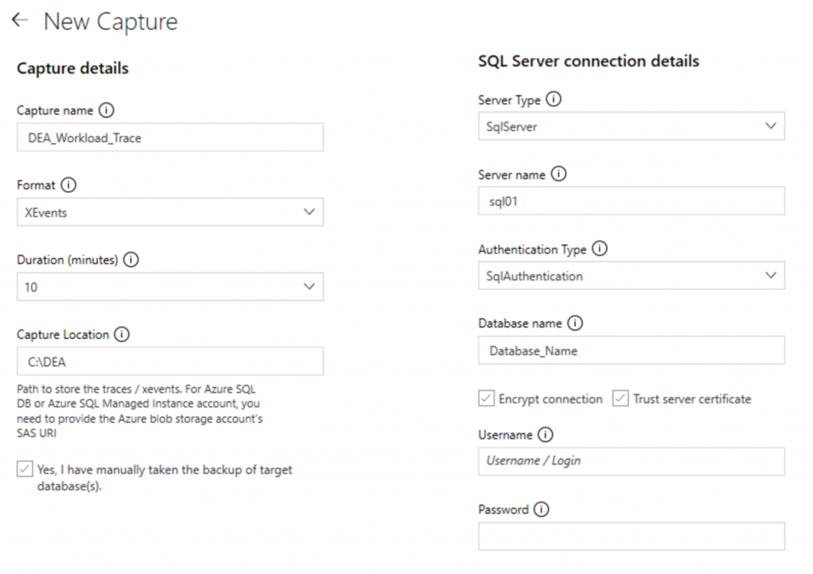
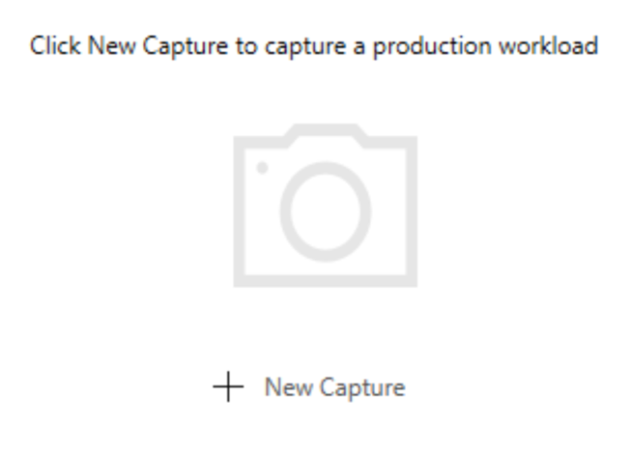
DEA 01
First step will be capturing the workload (Extended Event trace) from the source SQL server. Open DEA and select Capture Traces option | For this example I choose Extended Events trace option. Capture Location is a valid folder path on the SQL Server source machine where server side Extended Events XEL files can be stored. Make sure SQL Server account has write permissions on the folder specified. If you are using Azure SQL Managed Instance or Azure SQL Database as a source server you need to provide blob storage account as a Capture Location.

Slide 36
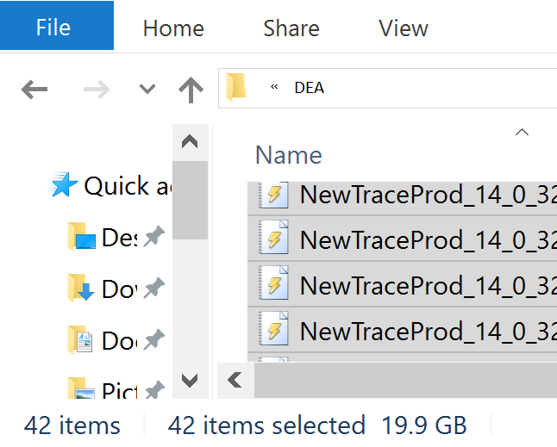
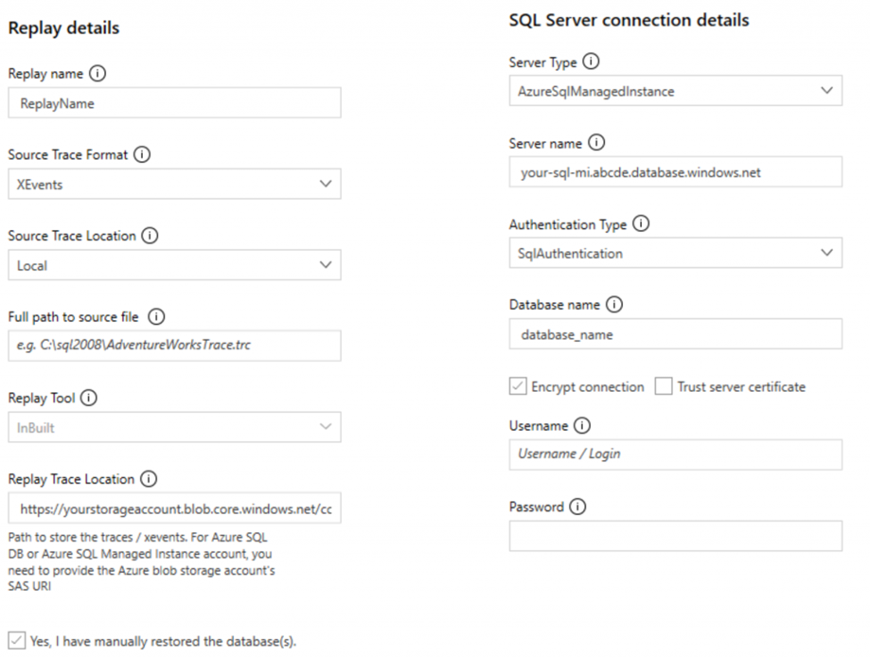
DEA 02
For this example I captured 10 minutes trace from production server. Exactly 42 files, size 19.9 GB (That depends on the traffic at the time) | Next step will be replaying the captured workload trace against your target environment. Source Trace Location will be location of your captured XE XEL files. Replay Trace Location will be blob storage account (URL + Shared Access Signature) since we are using Azure SQL Managed Instance as our targeted instance.

Slide 37
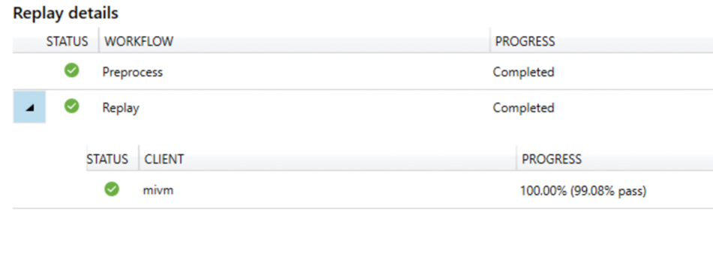
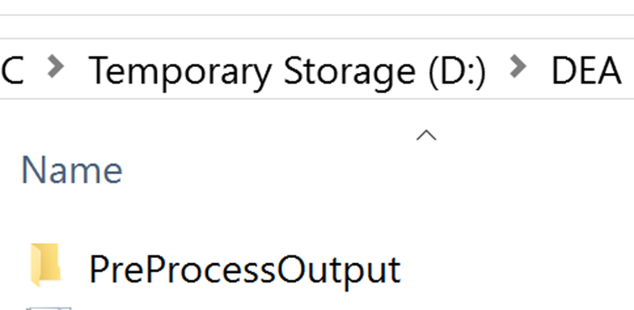
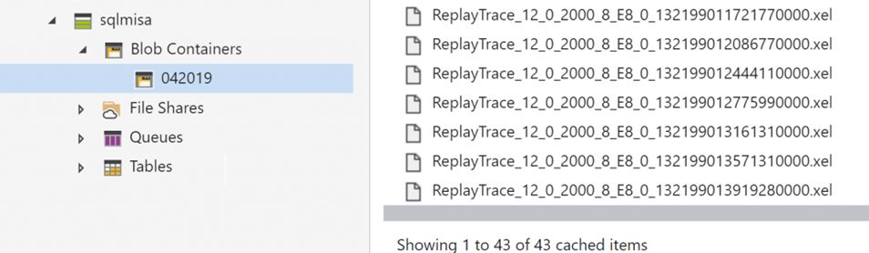
DEA 03
After you run replay, DEA tool will create a new sub folder within your Source Trace Location named PreProcessOutput, all Replay Markup Language (RML) files will be stored there. | After replay is completed you should have your XE XEL files in specified Replay Trace Location (Blob Storage Account)

Slide 38
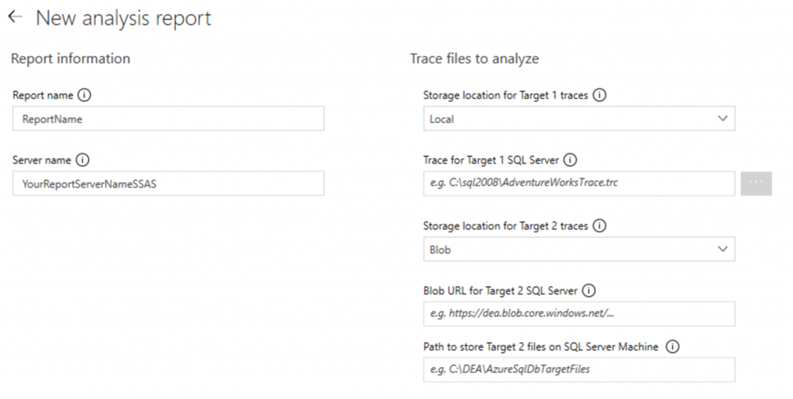
DEA 04
Next step will be analyzing the replayed collected workload traces. With DEA you can generate an analysis report which will help you understand what will be performance impact after migration. DEA analyze your workload and provides performance details for each query run on both Source SQL Server and target Azure SQL Managed Instance. | Trace for Target 1 SQL Server is actually path to the source server trace location. BLOB URL for Target 2 SQL Server is BLOB URL used when you replayed the workload trace against your target Server (Azure SQL managed Instance). Path to store Target 2 files on SQL Server Machine is location where DEA is going to copy files from the URL BLOB storage, so DEA can analyze those workload traces.

Slide 39
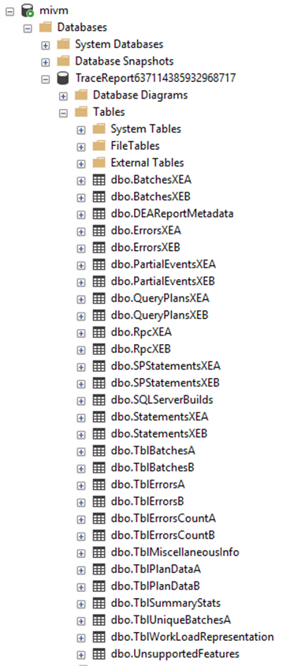
DEA 05
After providing all necessary information DEA will generate an analysis report using the replay traces and at the end will give you insights into your workload performance impact after migration. As well, DEA will create DB on your local SQL Instance (DEA VM).

Slide 40
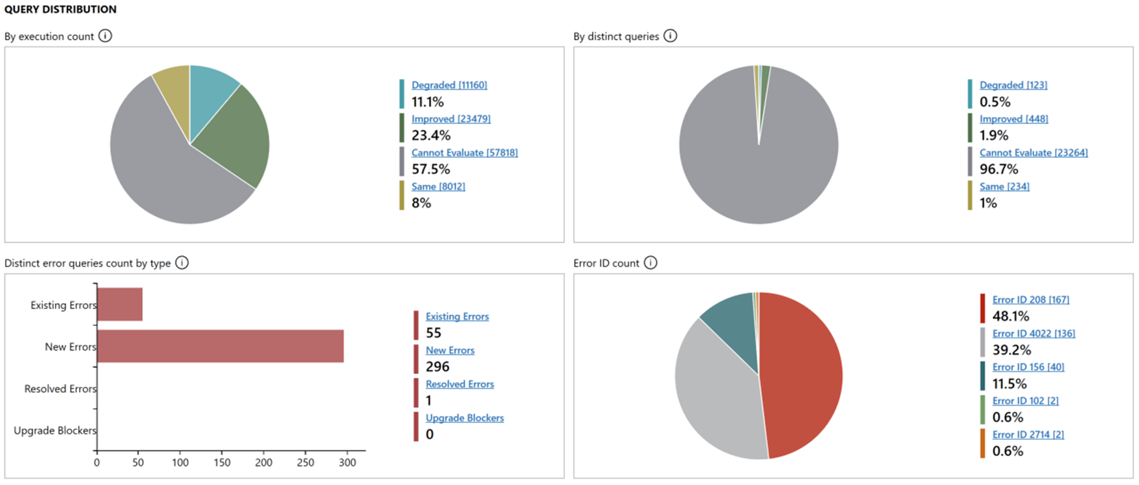
DEA Analysis Report example with the insights into your workload performance impact.

Slide 41
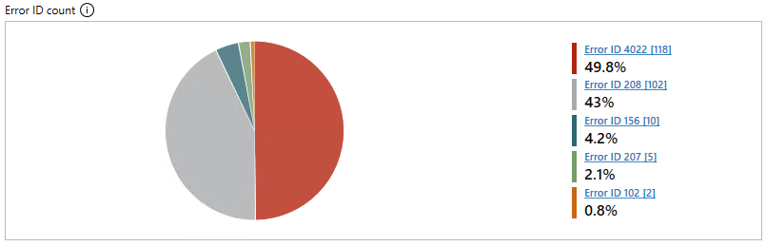
DEA Analysis Report example – Error ID Count report
Those are expected errors, we have queries creating temp tables, those temp tables do not exist on the target instance at time of workload execution.
Error ID 4022 - Bulk load was expected but not sent. The batch will be terminated.
Error ID 208 - Invalid object name.
Error ID 207 - Invalid column name.

Slide 42
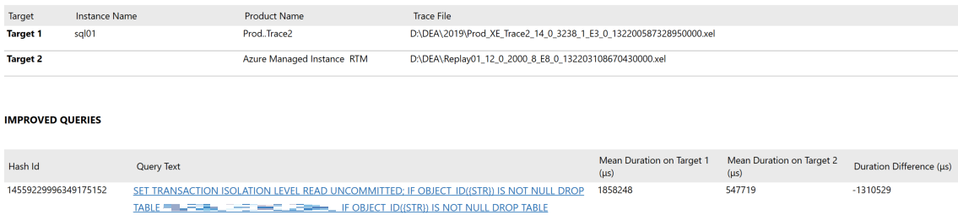
You can select improved queries by execution count from query distribution list to see more detailed information about specific queries.

Slide 43
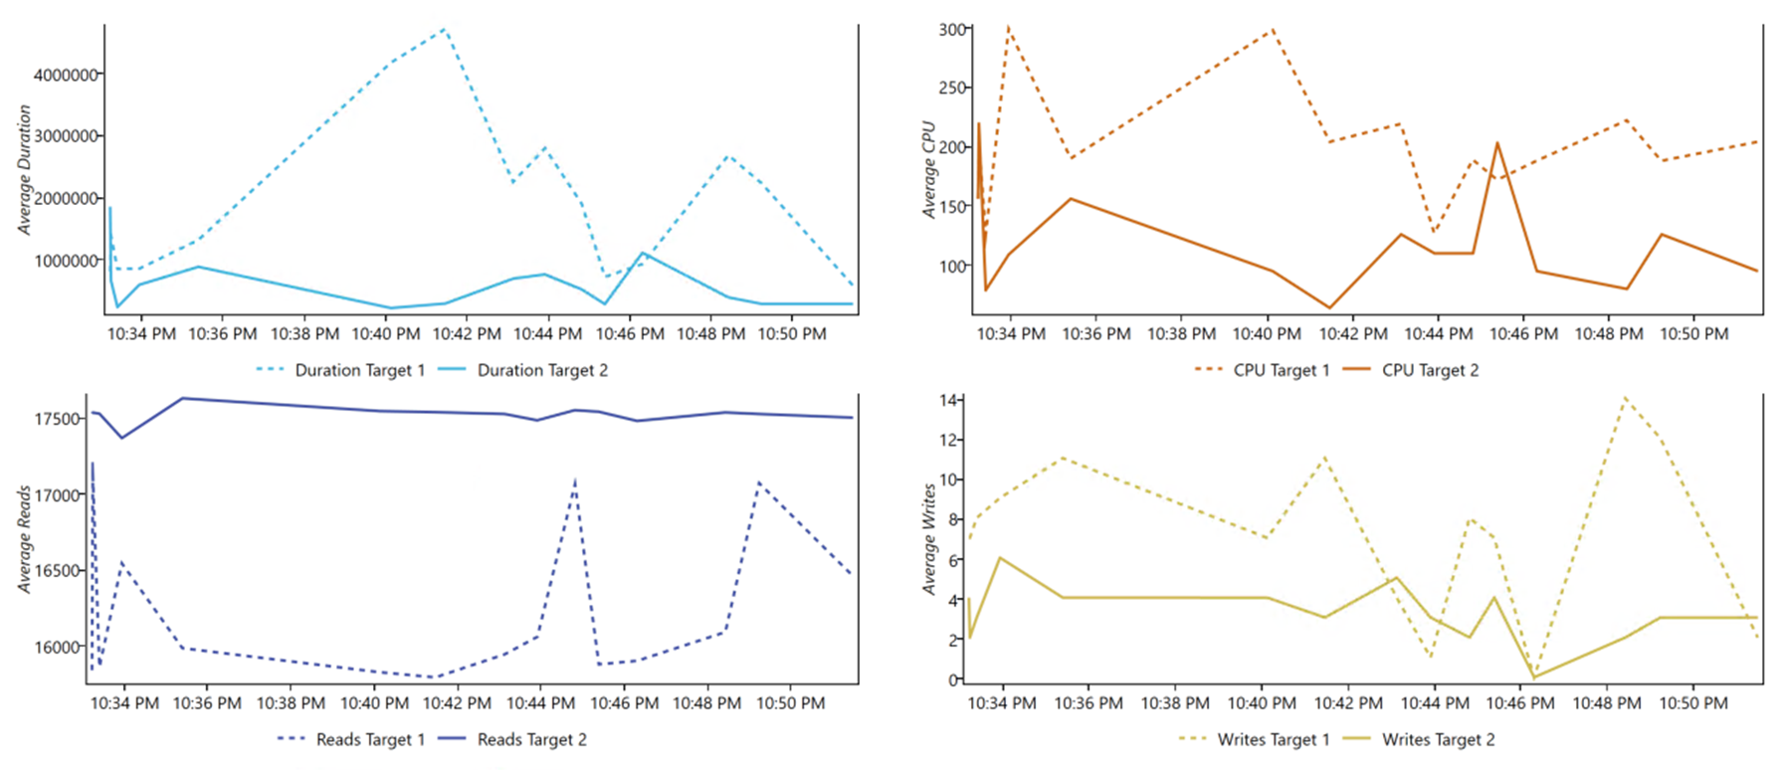
You can select specific query for more detailed information

Slide 44
Database Migration Services (DMS)

Slide 45
Database Migration Services (DMS)
Azure Database Migration Service is a fully managed service designed to enable seamless migrations from multiple database sources to Azure data platforms with minimal downtime (online migrations).
Azure Database Migration Service integrates some of the functionality of our existing tools and services. The service uses the Data Migration Assistant to generate assessment reports that provide recommendations to guide you through the changes required before performing a migration.

Slide 46
Database Migration Services (DMS)
Step by step

Slide 47
Database Migration Services (DMS)
For this example we are going to use following:
Azure Database Migration Service (DMS), Premium tier (4 vCores)
DMS Project: Online Data Migration
Source: SQL Server 2017, 8CPU, 64GB Memory
Target: Azure SQL Managed Instance, 16 vCores, 80GB Memory

Slide 48
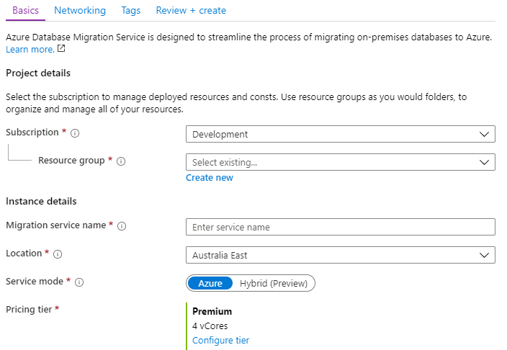
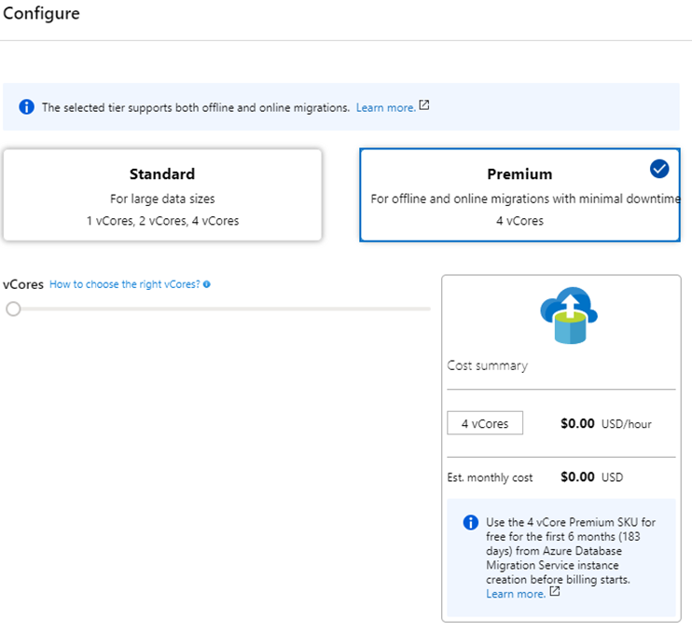
DMS 01
First step we will be to deploy Database Migration Service. Specify a name for the database migration service, and choose/create your resource group. | Configure your pricing tier. For this “Online type” of migration example I will use “Premium” pricing tier.

Slide 49
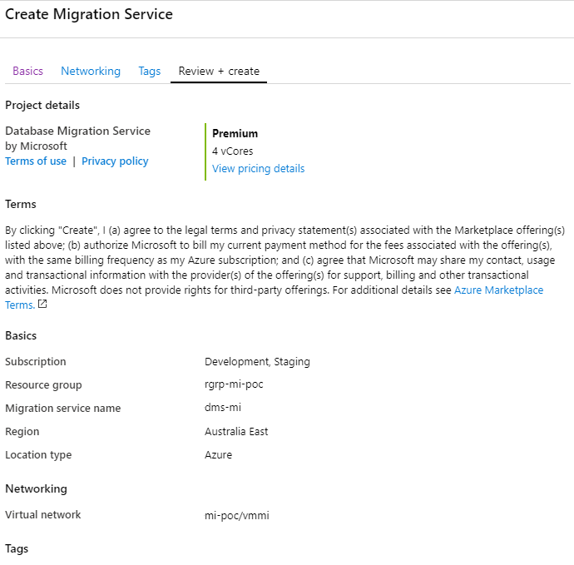
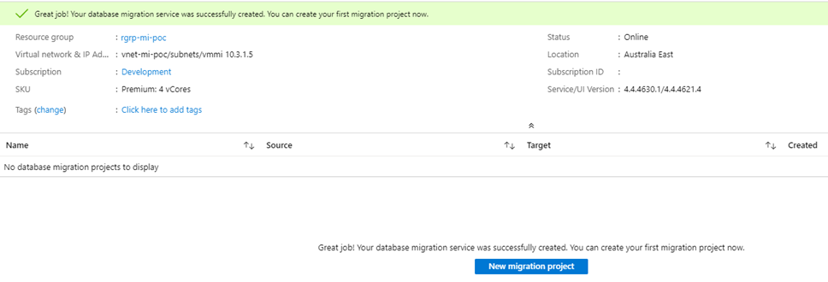
DMS 02
Select/create VNet. For this example I will the use the same VNet we used for our SQL Managed Instance (Target Server). Review and create Migration Service. | Once our service is deployed and online we can create our migration project.

Slide 50
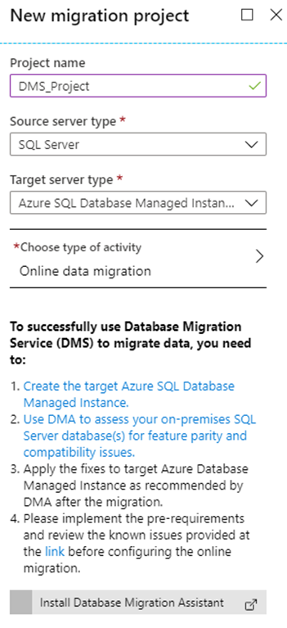
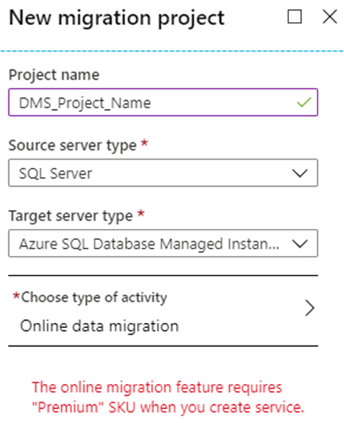
DMS 03
Choose project name, source server type, target server type and type of activity. | The reason why we choose premium pricing tier for our DMS was that the online migration feature requires “Premium” SKU DMS.

Slide 51
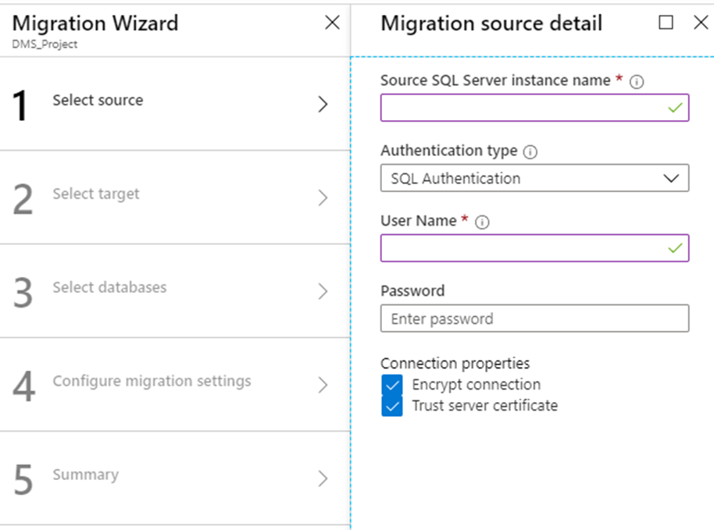
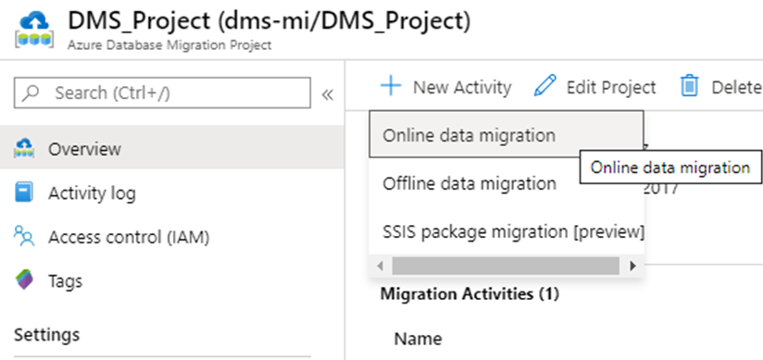
DMS 04
Once we have our Azure Database Migration Project we need to create new “Online data migration” activity. | Specify source details, connection details for the source SQL Server.

Slide 52
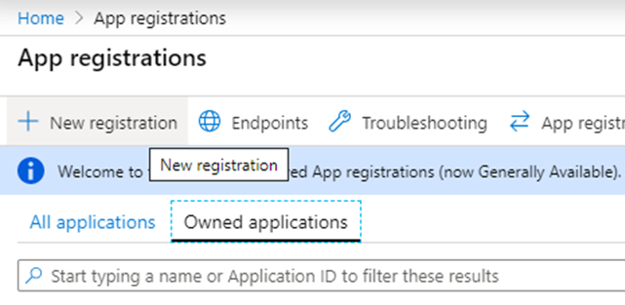
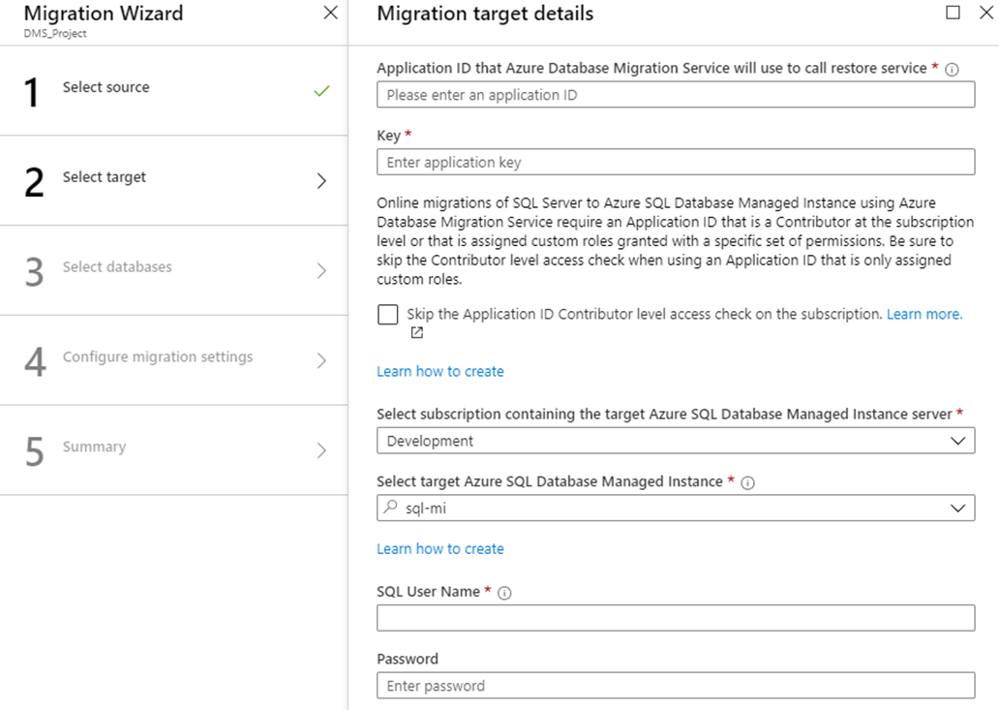
DMS 05
Specify target details, connection details for the target Azure SQL MI. You will need application ID that Azure Database Migration Service will use to call restore service. DMS uses the “application ID” to access the target Azure SQL Database Managed Instance resource and Azure Storage Account to perform online migrations. | To get application ID you need to use App registrations page and create new app registration.

Slide 53
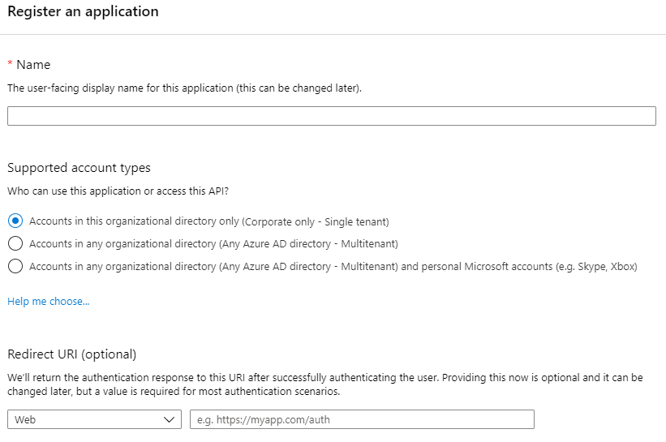
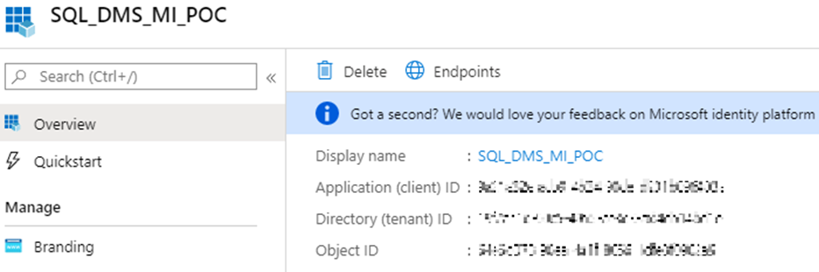
DMS 06
Register an application. | Once you have your app registered you should have Application ID

Slide 54
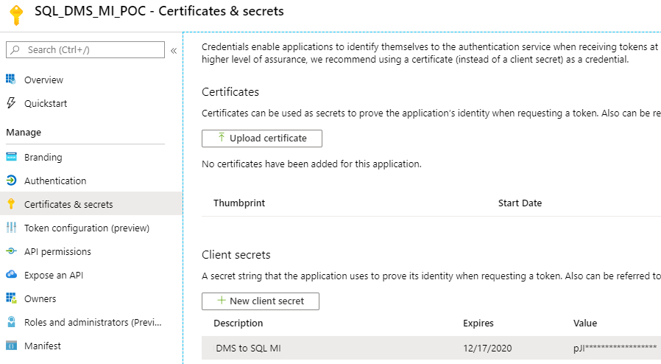
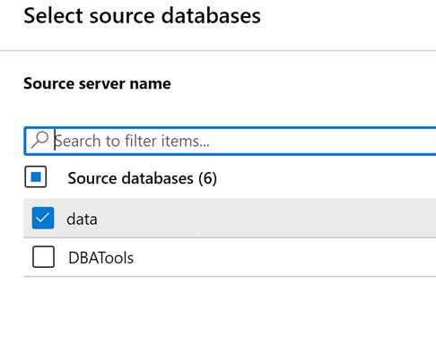
DMS 07
Next step is to select “Certificates & Secrets” and create new client secret. Client secret is a secret string that application uses to prove its identity when requesting a token. Also can be referred to as application password. You will use this as application key during migration target details configuration. | After you successfully connected to your target Azure SQL Managed Instance you can select source database you want to migrate.

Slide 55
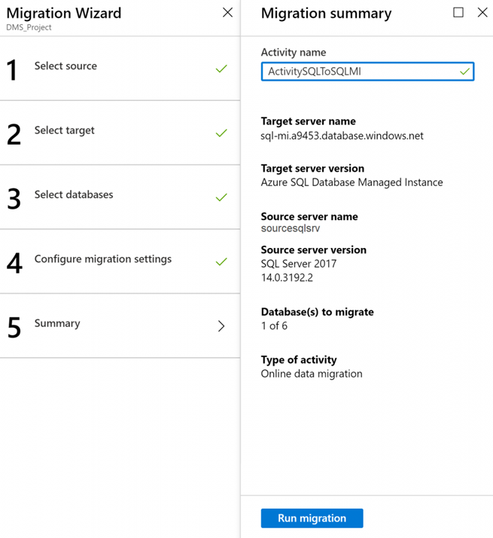
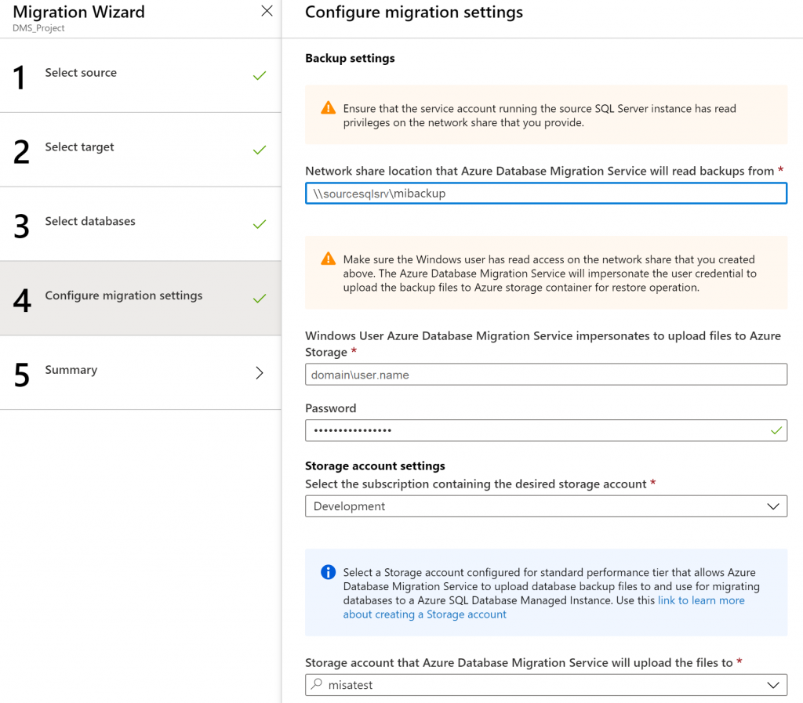
DMS 08
Choose network share location. Network share can be location on you source SQL Server. Make sure you use domain account which has read permissions on the network share location. Then select subscription containing storage account that allows Azure Database Migration Service to upload database backup files to, and use those files for migration database to our targeted Azure SQL MI. | Once we have all that, we can run our newly created project migration activity.

Slide 56
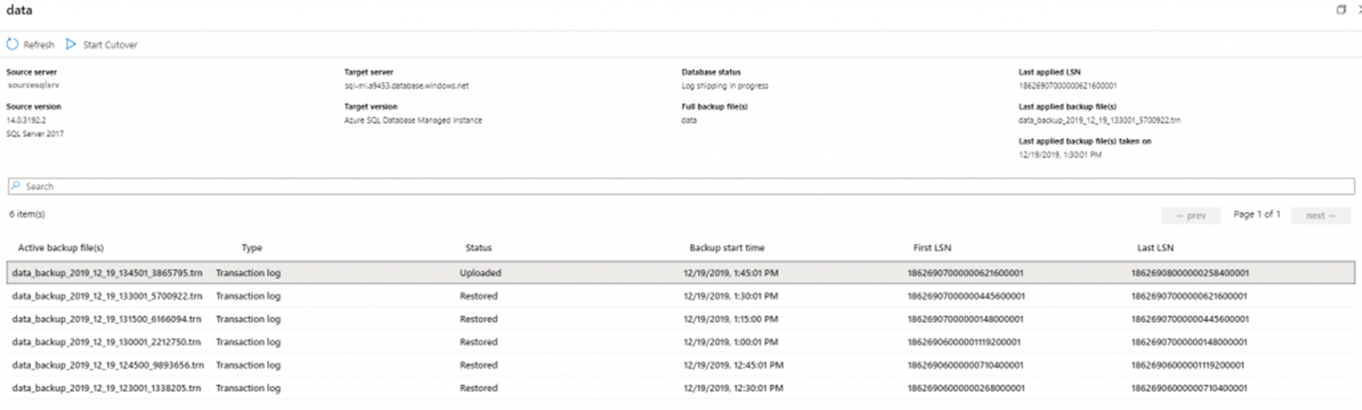
DMS Project Activity
Note.
Azure Database Migration Service only supports backups created using checksum.

Slide 57
Resources
https://blog.sqlserveronline.com/2019/10/30/azure-sql-managed-instances-migration-data-migration-assistant-dma-assess-on-premises-sql-server-instance/
https://blog.sqlserveronline.com/2019/11/11/azure-sql-managed-instances-migration-database-experimentation-assistant-dea-evaluate-your-workload-before-you-migrate-your-database-to-azure-sql-managed-instance/
https://blog.sqlserveronline.com/2019/12/23/azure-sql-managed-instance-database-migration-service-dms-online-data-migration-migrate-your-database-to-azure-sql-managed-instance/
https://docs.microsoft.com/en-us/sql/dma/dma-overview?view=sql-server-ver15
https://docs.microsoft.com/en-us/sql/dea/database-experimentation-assistant-overview?view=sql-server-ver15
https://docs.microsoft.com/en-us/azure/dms/
https://datamigration.microsoft.com/scenario/sql-to-azuresqldbmi?step=1
https://docs.microsoft.com/en-us/azure/sql-database/sql-database-managed-instance-resource-limits
https://docs.microsoft.com/en-us/azure/sql-database/sql-database-features
https://docs.microsoft.com/en-us/azure/sql-database/sql-database-paas-vs-sql-server-iaas

Slide 59


Thank You to our Global SQLSaturday Sponsors

Slide 60




About me
Zoran Barac
Data Architect @ CIN7
MCT, MCSE
zoran.barac.zof@gmail.com
blog.sqlserveronline.com
www.linkedin.com/in/zoran-barac/
www.meetup.com/Auckland-SQL-User-Group/

